Slide 1
The Atlantic Coast Joint Venture
Partners for Bird Conservation in the Atlantic Flyway
The Atlantic Coast Joint Venture
The Atlantic Coast Joint Venture is a partnership focused on the conservation of habitat for native birds in the Atlantic Flyway of the United States from Maine south to Puerto Rico. The partnership consists of 17 states and commonwealths plus key federal and regional conservation agencies and organizations in the joint venture area. The joint venture was originally formed as a regional partnership focused on the conservation of waterfowl and wetlands under the North American Waterfowl Management Plan in 1988. The joint venture has since broadened its mission to the conservation of habitats for all birds consistent with major national and continental bird conservation plans.
Achieving Our Goals
Atlantic Coast Joint Venture partners recognize the benefits of working together to achieve common goals for bird conservation in the Atlantic Coast region. We jointly develop sound science to assess the status and needs of bird species; identify priority geographic areas and habitat conservation actions and evaluate the impact of conservation through monitoring and research. We work together at regional, state and local scales to implement priority conservation projects. We utilize a small amount of federal funds to leverage and attract a much larger amount of matching funds in pursuit of these common goals.
A Model That Works
Over five million acres of significant habitats have been protected restored and enhanced for migratory birds by joint venture partners from the inception of the joint venture in 1988 to the present. The strong partnership and sound scientific foundation have targeted this conservation to the most important habitats and geographic areas for migratory birds and allowed us to evaluate the effectiveness of these conservation actions. The joint venture approach is now allowing us to address additional challenges such as impacts due to climate change and to work collaboratively with other partners on the conservation of habitats for other wildlife and fish species.
February 2012
Common Yellowthroat, USFWS; Egret peening, William Majoros; Red Knot, Greg Breese; Duckling, William Majoros

Slide 2
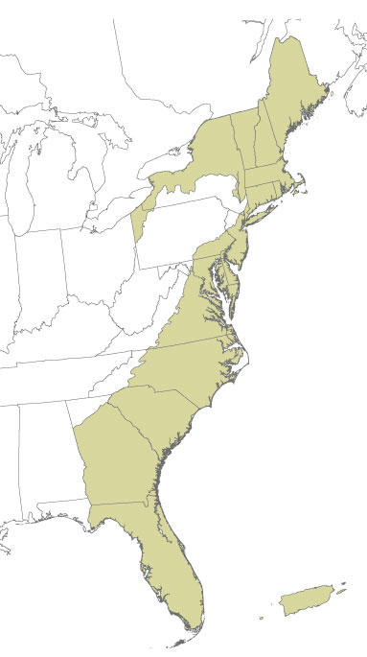
Conservation Projects
Conserving Working Forests in the Northeast
ACJV partners have conserved over a million acres of working forest in northern New England and New York, protecting important habitat for birds and other wildlife while allowing for compatible timber harvesting.
Science Projects
Designing Sustainable Landscapes
The “Designing Sustainable Landscapes” project being implemented by the ACJV along with the U.S. Geological Survey, U.S. Fish and Wildlife Service and a number of universities is allowing partners to answer questions including how much habitat protection, restoration and enhancement is needed where to sustain bird and other wildlife populations. Tools and maps developed through this project will guide habitat conservation funding to the highest priority areas based on current conditions as well as predicted future conditions that take climate change and urban growth into account.
ACJV boundary
Facing Challenges
In the Atlantic Coast Joint Venture area, climate change is predicted to result in significant changes to habitats including sea level rise impacts on coastal habitats and the effects precipitation and temperature will have the distribution and composition of wetland and upland communities and the bird species that depend upon them. As a regional partnership of federal, state and regional conservation agencies and organizations, the joint venture is coordinating assessments of the impacts of climate change and adapting conservation strategies to address these impacts at flyway and ecoregional scales.
For More Information
Contact Mitch Harltey, Coordinator
413/253 8779
Mitch_hartley@fws.gov
www.acjv.org
Coastal habitat. USFWS
Fall colors. USFWS
Wetland. USFWS
Katahdin Mountains. USFWS

