Slide 1
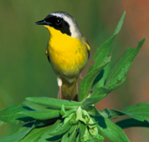
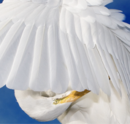
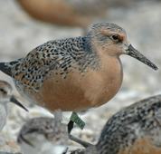
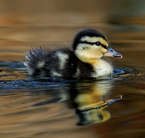
Your Joint Venture
Conserving birds and their habitats
A Fact Sheet Template for all JVs
The National JV Communications, Education, and Outreach Team has created this template to assist you in developing a fact sheet to accompany the National JV fact sheet.
Our goal was to create an easy-to-use template that would have a similar look and feel to the National JV Fact Sheet, but that could be used by those without graphic design expertise. If you would like the original Adobe InDesign files for the National Fact Sheet, contact Debra Reynolds (debra_reynolds@fws.gov).
How To Use This Template: Tips and Suggestions
All text and image placements are simply suggestions. We encourage you to change headings, incorporate your own pictures, and move things around to make this fact sheet the most useful for your JV.
Do not be afraid of blank space! Too much text makes readers set your fact sheet aside.
Things To Keep In Mind
KNOW YOUR AUDIENCE! Remember that they are likely reading many fact sheets, so you want your to stand out in a positive way.
Remember the 3-30-3 principle:
If you have your audience for 3 seconds, you want them to remember who you are.
If you have them for 30 seconds, you want them to remember the basics of your message (have good headings).
If you have them for 3 minutes, they might read most of the fact sheet.
Common Yellowthroat, USFWS; Egret preening, William Majoros; Red Knot, Greg Breese; Duckling, William Majoros
February 2012

Slide 2
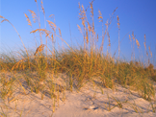
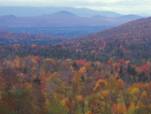
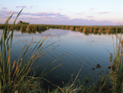
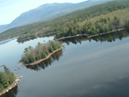
Background Color/Theme
If you do not like the brown color on the first page, PowerPoint allows you to change this to either one of a number of pre-set themes or the color of your choosing. To do this, right click on a blank part of the first page. Select “format background”. Choose your desired color.
You can use the same method to change the color of the boxes and bars around the front page photos, as well.
Include an easy-to-understand map of your Joint Venture region.
Fonts Suggestions
Title Font is Century Gothic 24 bold
Tagline is Century Gothic 18
Headings are Calibri 14 bold.
Text is Century Gothic 12
Photo credits are Calibri 9 Italic. Anything between 8 and 10 point is fine to use.
Headings can go as small as 12 font bold and text can go as small as 10.
Image Resolution and Size
Image resolution, in general, is better for printing starting at 150 dpi. Below we provide the dimensions in pixels of the template images:
Front page images: width 178 x height 170 pixels
Back page images: width 162 x height 122 pixels
JV boundary image: width 238 x height 219 pixels
If you can, resize your images (with a program like Photoshop) before importing into PowerPoint. If you need to re-size images within PowerPoint, click on the image, hold down the ‘shift’ key, move your cursor to a corner of your image until you get a double-headed arrow, and adjust your image to the desired size.
For More Information
Insert your contact information here, including an email and your website.
Coastal habitat. USFWS
Fall colors. USFWS
Wetland. USFWS
Katahdin Mountains. USFWS

